Slide 1
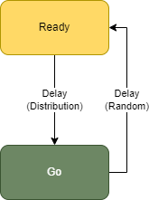
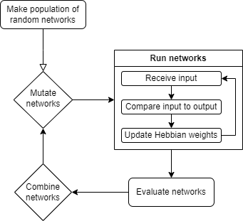
Evolving Biologically Plausible Networks for Temporal Prediction
Ready-Go Task
Hebbian Learning
NeuroEvolution of Augmenting Topologies (NEAT)
Sondre H. Elgaaen, Felix B. Kern, Zenas C. Chao
A timing-task [foreperiod…]
aimed at developing networks whose only function is to encode the information needed to learn timings.
A Ready-signal is sent to prepare the network for a coming Go-signal, whose timing the network is made to predict. [Repeated for different intervals using the same network.
Hebbian Learning postulates that the increase in connection strength between two neurons is promoted by concurrent spiking activity.
Or in short: “Neurons that fire together, wire together”
By utilizing an unsupervised variant of Hebbian Learning, known as Spike-Timing Dependent Plasticity, the generated networks implement plasticity, allowing them to learn in a biologically-plausible manner.
Combine NEAT and Hebbian Learning to evolve biologically plausible RNNs capable of learning multiple time-dependent sequences.
By finding topologies that solve the problem domain, we might learn about the corresponding processes in the brain.
NeuroEvolution of Augmenting Topologies (NEAT)
Ready-Go Task
Combine NEAT and Hebbian Learning to evolve biologically plausible RNNs capable of learning multiple time-dependent sequences.
By finding topologies that solve the problem domain, we might learn about the corresponding processes in the brain.
A timing-task aimed at developing networks whose only function is to encode the information needed to learn timings.
A Ready-signal is sent to prepare the network for a coming Go-signal, whose timing the network is made to predict.
Conclusion
Network placeholder
Network placeholder
Network placeholder
Network placeholder
Acknowledgements
Shoji Takeuchi
Kazuki Nishimoto
Morie Watanabe
Yuri Marugata
Kaori Sato
Fujiwara Kantaro
Keith L. Downing
The Norwegian Government
Results placeholder
Results placeholder
Results placeholder
Results placeholder
Hebbian placeholder
Bigger?
Notes:
Add goal and conclusion
Conclusion?
“Structures can be learned”
“this or this is difficult”
“NEAT + Hebbian = good tool for finding biologically plausible topologies”
Acknowledge:
IRCN server guy
Norwegian government (Lånekassen)
Extention: Takeuchi-senset, Watanabe-san
Keith L. Downing

